Slide 1
The Abstract Factory Pattern

Slide 2
A software design pattern, the Abstract Factory Pattern provides a way to encapsulate a group of individual factories that have a common theme. In normal usage, the client software would create a concrete implementation of the abstract factory and then use the generic interfaces to create the concrete objects that are part of the theme. The client does not know (nor care) about which concrete objects it gets from each of these internal factories since it uses only the generic interfaces of their products. This pattern separates the details of implementation of a set of objects from its general usage.

Slide 3
An example of this would be an abstract factory class DocumentCreator that provides interfaces to create a number of products (eg. createLetter() and createResume()). The system would have any number of derived concrete versions of the DocumentCreator class like FancyDocumentCreator or ModernDocumentCreator, each with a different implementation of createLetter() and createResume() that would create a corresponding object like FancyLetter or ModernResume. Each of these products is derived from a simple abstract class like Letter or Resume of which the client is aware. The client code would get an appropriate instantiation of the DocumentCreator and call its factory methods.

Slide 4
The client would need to know how to handle only the abstract Letter or Resume class, not the specific version that it got from the concrete factory.
In software development, a Factory is the location in the code at which objects are constructed.

Slide 5
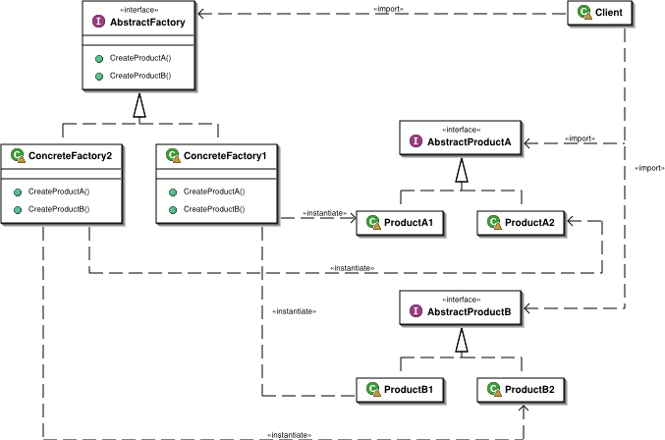

Slide 6
Java Code
/* * GUIFactory example */
public abstract class GUIFactory {
public static GUIFactory getFactory() {
int sys = readFromConfigFile("OS_TYPE"); if (sys == 0) {
return(new WinFactory());
}
else {
return(new OSXFactory());
}
} public abstract Button createButton();
}

Slide 7
class WinFactory extends GUIFactory {
public Button createButton() {
return(new WinButton());
}
}
class OSXFactory extends GUIFactory {
public Button createButton()
{
return(new OSXButton());
}
}

Slide 8
public abstract class Button {
private string caption;
public abstract void paint();
public String getCaption(){
return caption;
}
public void setCaption(String caption){
this.caption = caption;
}
}

Slide 9
class WinButton extends Button {
public void paint() {
System.out.println("I'm a WinButton: "+caption);
}
}
class OSXButton extends Button {
public void paint() {
System.out.println("I'm a OSXButton: "+caption);
}
}

Slide 10
public class Application {
public static void main(String[] args) {
GUIFactory aFactory = GUIFactory.getFactory();
Button aButton = aFactory.createButton(); aButton.setCaption("Play"); aButton.paint();
}
}

